Slide 1


PROJECT TOPICS
Presenter :
ROHIT P
AM.EN.P2GEO22002

Slide 2
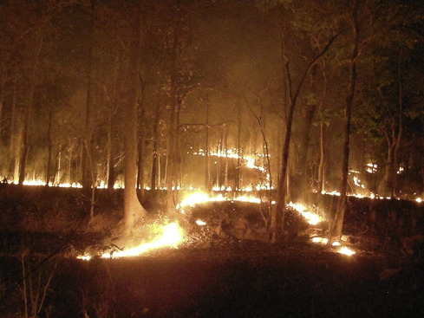
FOREST FIRE DETECTION SYSTEM
The temperature sensor detects the warmth and smoke sensor detects any smoke produced because of consuming or fire.
Forest fires are common hazards in forests that cause a lot of harm to Wildlife as well as the Environment. It could be avoided if a robust system could be deployed in forest areas to detect the fire and alert to Fire extinguishing authority to take immediate action.
Arduino Nano
SIM800L GPS/GPRS Module
3.7V Li-ion Battery
Flame sensor
Dot matrix Perf board

Slide 3

SMART AGRICULTURE
As the world population has grown, so has the need for secure food supplies and improved agricultural practices. Increasing demand for better quality and larger quantities of food has led to the rapid modernization of the industry, with advances in technology, infrastructure, and improved growing methods being developed in recent decades. The Internet of Things provides promising applications for the modern agricultural sector.
NodeMCU ESP8266 Board
Capacitive Soil Moisture Sensor
0.96" I2C OLED Display
DHT11 Sensor
1 Channel 5V Relay Module
5V DC Motor Pump
Connecting Wires
Breadboard

Slide 4
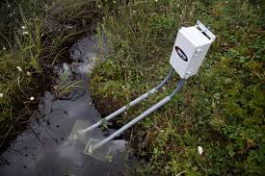
WATER QUALITY MONITORING SYSYEM
We created a working prototype of a wireless groundwater sensor module that collects and transmits real time geological formation data from far away places. Water quality monitoring equipment, data acquisition equipment, and knowledge transmission structure make up the water quality monitoring system.
Ph, Turbidity TDS and water temperature are usually monitored to assess the water quality comprehensively, which might basically reflect the water condition, data transmission systems are mainly divided into wired transmission and wireless transmission

Slide 5




Thank you

